Slide 1
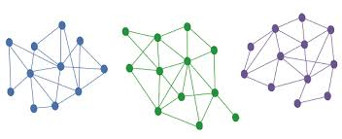


Leading With Authenticity In The Health Sector
MHA/542
Instructor: Debra Williams
By: Yadira Castro, Znobia Cannon, Laquanda Grant, Donnette Williams, Austin Wolf, and Tippy Tanu-Munford, Merna Ayad

Slide 2

WHAT IS COMPLEXITY LEADERSHIP?
ALTERNATIVE APPROACH
CREATIVITY
COLLABORATION
INNOVATION
Notes:
Complexity Leadership enables companies to utilize alternative measures that involve creativity, collaboration, and innovation that allow organizations to adapt to chaotic and unpredictable times (Belrhiti, Z.,Nebot Giralt, A., & Marchal, B., 2018). Complexity allows companies the capability to change and survive. For example, when Covid-19 occurred this year, most companies did not offer work-at-home options. However, to adapt to the current pandemic, organizations began to offer their employees the option to work at home to maintain and continue the business. This is an example of creativity, collaboration, and innovation.

Slide 3
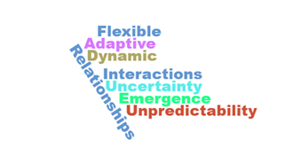
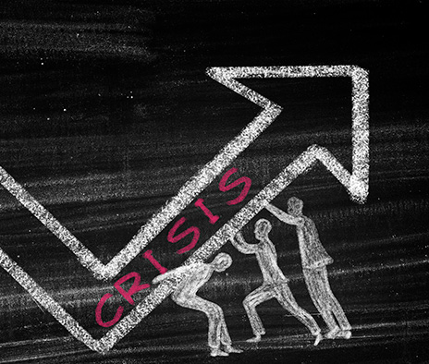
INTRODUCTION
COVID-19 CRISIS
LEADERSHIP
FLEXIBILITY
OPENNESS
Notes:
Our Team has selected the leadership challenge that many of us are still facing or working through. Covid 19. As many of us started 2020, we called it the year of vision. We never saw this crisis coming or ever imagined how it would change our jobs, our communities, our families and health care as a whole. In this presentation we will discuss how complexity leadership played a major role through the process and continues to be essential to our response and follow up; as is the pressure we are all under. This pressure kept the walls of resistance and rigidness down and enabled collaboration. As we move forward we need to keep the walls of resistance down, maintain the openness and collaboration through many entities in healthcare. Healthcare continues to come together and work together in an open, and more trusting environment which has developed better relationships to enable change as we navigate through this unknown territory

Slide 4
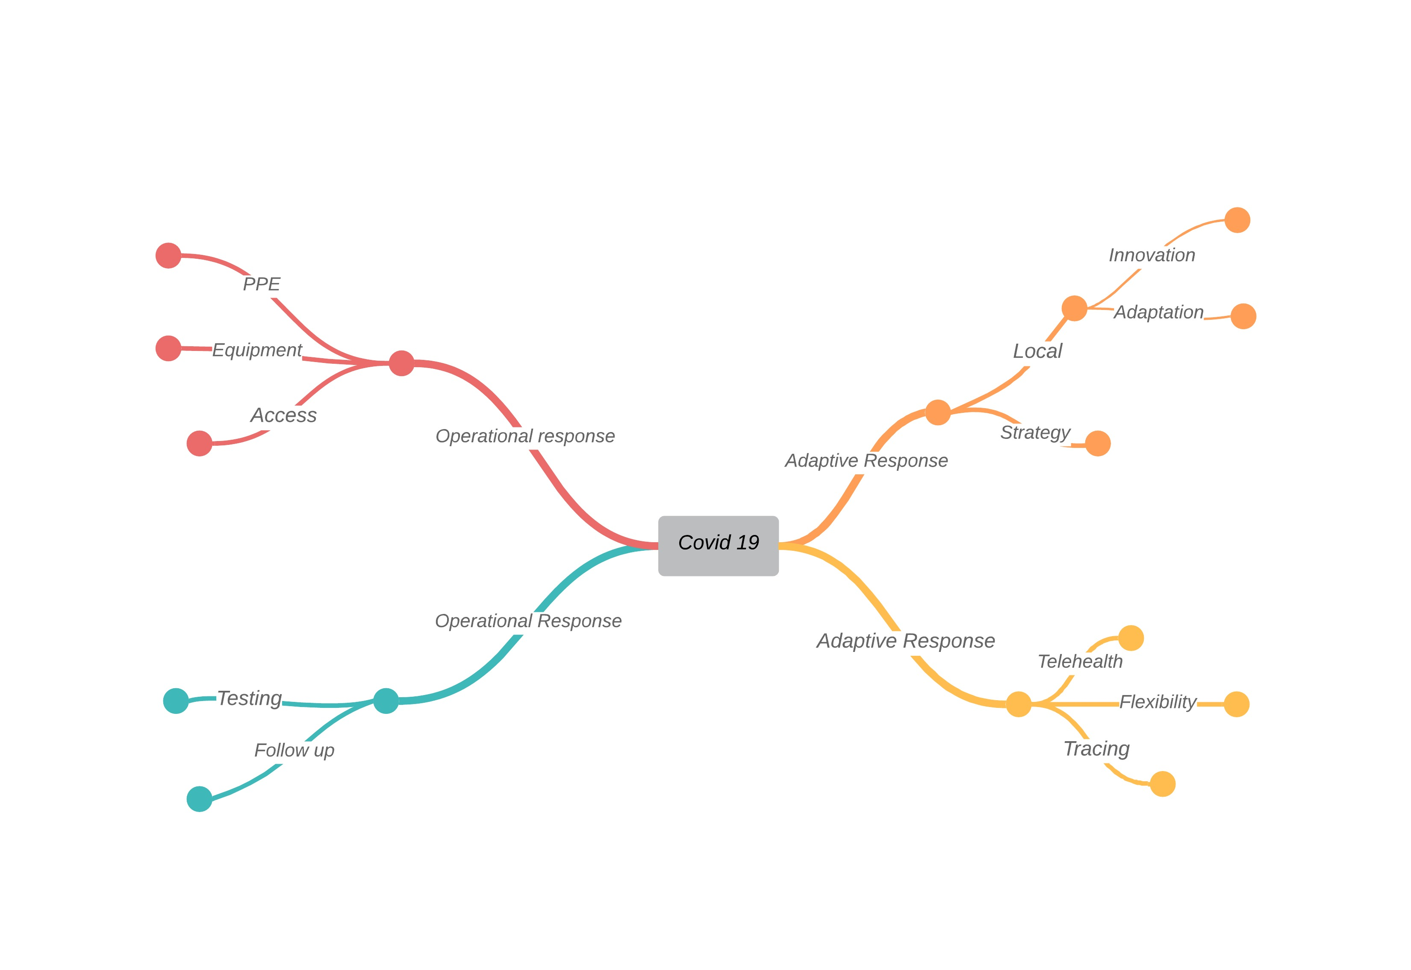
MAP IT OUT
Notes:
We had to accept that covid 19 was happening to have the appropriate response. As a team we discussed that this was a challenge in many health care settings . However others went into operational responses that covered equipment, access protective gear, testing, follow up . We needed to have an adaptive response strategy at the local level, telehealth, innovation adaptation, flexibility. This is our map of thoughts as it relates to complex leadership and covid 19. In the following slides we will go in depth with the process and approach

Slide 5
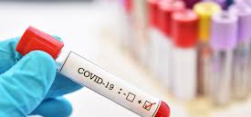


ADAPTIVE RESPONSE
Notes:
In 2020, the world we know it encountered a challenge never seen before. COVID-19 catastrophically impacted not just our nation but the entire world. The Healthcare industry was caught off guard, and leaders encountered a crisis they were never prepared or equipped to handle. Today, healthcare leaders must think creatively and start operating outside of their comfort zone. Today, it is time for leaders to have an adaptive response as we continue to fight against COVID-19. “Developing an adaptive response has become even more important as time goes on, and we recognize more facts, and new knowledge comes to bear” (Nosta, 2020). Adaptive response during COVID-19 will allow healthcare leaders to face challenges encountered and brought upon by the pandemic through the collective efforts of individuals, groups, networks, and not just one particular person or expert. Allowing collaboration from different experts, organizations, groups, or individuals can help the healthcare industry develop and implement solutions that will benefit the industry and patients long term. COVID-19 is a challenge we have never encountered before and utilizing adaptive response will ensure we develop appropriate measures to combat this virus. The adaptive response will allow healthcare leaders to develop measures that highlight patient safety, ensure facilities are equipped with proper resources from staffing, testing supplies, and all necessary equipment to ensure the safety of our patients and staff members. The year 2020 is not the time to worry about hierarchy or who is in charge, but it is the time for all to come together, collaborate, and work as one as we continue our fight against COVID.

Slide 6

ORGANIZING FOR ADAPTABILITY
HOLD CREATIVE BRAINSTORMING SESSIONS
DECENTRALIZE DECISION MAKING
MAKE ADAPTABILITY A CULTURE VALUE
WELCOME AND ACCEPT FAILURE
ENCOURAGE CROSS-TRAINING
DIVERSITY TEAM
FLUID ROLES
Notes:
Facing challenges brought upon by the COVID-19, the healthcare industry and its leaders must be creative and take a different approach to ensure we recover and sustain any additional hurdles associated with this pandemic. With that, healthcare leaders must start working towards incorporating adaptability into routines and start organizing for adaptability. As the environment and the world around us continue to change, and the pandemic continues to bring upon different and more challenges, the healthcare leaders must use an adaptive system that can be flexible and operate no matter the environment. To accomplish that, we must start incorporating certain practices into our routine to promote and strengthen our ability to adapt. Fourteen solutions are recommended for leaders to follow to assist with adaptability in their organizations.
We must hold a creative brainstorming session (Young Entrepreneur Council, 2020). Through these sessions, leaders and organizations can collaborate and discuss ideas that will help develop valuable industry measures in the long run.
As stated in the previous slide, during these difficult times, it is not wise to focus on who should make a decision; now is the time that we all must work together and allow for the decision-making process to be decentralized. Flexibility is the key.
Dealing with change can be a challenge of its own, but if leaders promote and encourage growth, improvement, and every opportunity to evolve, handling changes can be manageable. Leaders must make adaptability a part of the organization’s culture (Young Entrepreneur Council, 2020).
As leaders, we must welcome and accept failure. As we continue to face the challenges of COVID-19, we must acknowledge our failures and learn from them. We will find answers on how to prepare better and bridge any gaps that existed before the pandemic through our struggles and failures. Our failures will help us develop answers for the future.
It is also essential for leaders to encourage cross-training within their organizations, hire a diverse team, and make roles fluid. By cross-training individuals encourages growth and continuous learning. Cross-training individuals to perform basic tasks can ensure that specific individuals will not feel overwhelmed during a pandemic or avoid individuals performing duties they have not been trained on before. Cross-training can also help with building a diverse team. Having a diverse team allows for room to have a variety of talent and experience on the team. Different experiences can bring different views and approaches to doing things. By having a diverse team that is cross-trained can make fluid roles a little more manageable. Understanding that roles can change is good, but even better when individuals have the experience and have been trained to perform the duties.

Slide 7
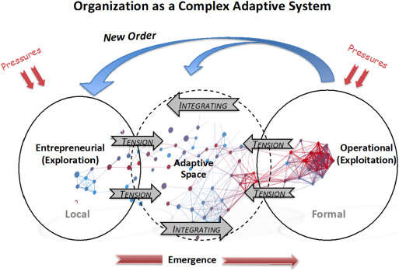
ORGANIZING FOR ADAPTABILITY (CONT’)
MAKE COMMUNICATION A PRIORITY
ENCOURAGE & RECOGNIZE INNOVATION
TAKE CONTROL & NOT REACT
THINK THROUGH THE WHAT-IFS
INCORPORATE FLEXIBILITY
PLAY TO WIN, NOT JUST TO SURVIVE
BE THERE FOR EACH OTHER
Notes:
In the previous slide, we discussed the first seven approaches to organizing adaptability in the organization. Through adaptability, we can be prepared and stay ready for what might come. We will continue to the remaining seven approaches that will help healthcare leaders with being adaptive.
Communication, no matter the situation, is important in the success of any organization. Leaders must encourage and promote the importance of communication (Young Entrepreneur Council, 2020). Communicating changes, new trends, best practices, results, or data during COVID is vital to ensure healthcare leaders implement appropriate approaches to combat the situation.
This is the time innovation is encouraged and should be recognized. There are times out of the box, and creative thinking is necessary, and as we continue this journey during the pandemic, innovation and all ideas must be encouraged and promoted.
Thinking through all possible what-ifs situations will help leaders with taking control of the situation and avoid reacting. There were gaps in our healthcare system that leaders noticed before, but we are now forced to bridge gaps and find ways to mitigate them through the pandemic. Collaboration and discussing all possible what-ifs situations can help leaders develop measures that will ensure reacting will no longer be the healthcare industry’s response to any crisis in the future. Staying proactive and not reactive is the focus. Keep in mind that things happen; we must be prepared to handle any situation, so it is crucial to promote flexibility. Being flexible is vital in the long run, and help leaders ensure we are in it to win it and not just doing what we can to barely surviving. We are tasked with a critical mission of saving lives and taking care of our people. We must have strategies to help us win this fight against COVID and anything else that might come. Not only should we be prepared, but we must also remember to take care of one another. We cannot fight and win without everyone playing their role. Every hand and contribution plays a vital role as we move forward; we must all acknowledge everyone’s contribution and take the time to take care of each other. Everyone is important, and together we can win the fight against COVID.

Slide 8

THE CONSTRAINTS
OF
BUREAUCRACY
Health/social impact
Economic Impact
Fiscal Impact
Regional and local Impact
Notes:
In 2020, COVID-19 has affected nearly all countries and eight million people. This has caused the governments to operate in a thoroughgoing unpredictability. According to OECD (2020), governments are dealing with problematic compromises due to the circumstances of the causes more challenges for countries health, economic status, and social status. COVID-19 has cause over half of the worlds business and population to have to shutdown/lockdown. OECD (2020) stated that a severe economic catastrophe has happened due to the lockdowns. Regional governments are in control of the rules of lockdown for health care and social services. There has many impacts on the healthcare. Health/ social impact has happened in urban areas due to more COVID cases and them being exposed more. Next, OECD stated that the economy has had an impact. To try and contain the exposure business had to go on lockdown. Fiscal impact is from the pandemic increasing spending and cause a decrease in income for regional government. With lockdown and health/social, economic, and fiscal impacts, this has caused a large impact on regional and local governments. Governments and organizations must adapt to over come the protocols of COVID to be able to function appropriately.

Slide 9
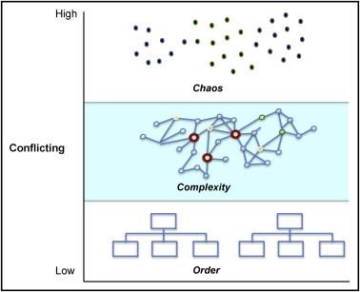
COMPLEXITY DYNAMICS
&
NETWORK STRUCTURES
Both chaos and complexity designs are related.
However, chaos deals with how one can use simple systems in generating complex behaviors while complexity structures deals with how simple behaviors emerge from complex systems.
Chaos and order are related, thus been merged to form chaordic system.
Notes:
In workplace, there is need to have different systems in place. All new organizations tend to have a new dynamic systems which are characterized by emergence and adaptation. In order to operate smoothly, the management and leadership skills needs to change with dynamic systems in order to cope with new environment. In complexity, the managers don’t need to look for the equilibrium but rather be adaptive, flexible and innovative. Chaos on the other side is characterized by simple, non linear systems that generates very complicated behaviors that are sensible to the initial conditions. Chaos and order are inter-related in a way forming chaordic system. Introduction of order brings new perspective of seeing things as well as bringing up new concepts such as reductionism, positivism, determinism, conservation and mechanism. Thus, order involves opening up new concepts and moving towards understanding the complex systems.

Slide 10

THE ROLE
OF
PRESSURE
EQUIPMENT
STAFFING
CAPACITY
UNKNOWN
Notes:
Covid-19 has been raising havoc on human lives. The pandemic has caused tremendous pressure on healthcare leaders. Healthcare leaders are under pressure to ensure the staff and patient’s safety remain the priority while still providing quality care. For instance, healthcare leaders are pressured to find Personal Protective Equipment (PPE) to protect frontline workers and patients. Another pressure is having necessary equipment vital to providing care to patients, such as additional beds and incubators. Healthcare leaders also have pressure in finding enough staff to provide quality to patients to include those affected by Covid-19. Faced with the unknown of what to expect next, the pressure is taking a toll on healthcare leaders physically, mentally, emotionally, and psychologically. Blake et al. (2020) states, "the extreme pressures experienced by healthcare workers during a pandemic may increase their risk of burnout, which has adverse outcomes not only for an individual's well-being but also for patient care and the healthcare system" (p. 2).

Slide 11
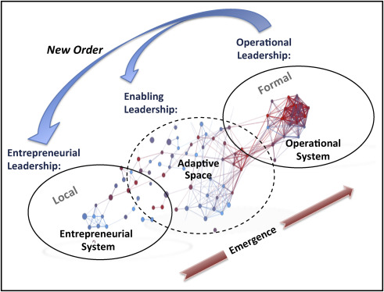
LEADING
FOR
ADAPTABILITY
Notes:
Healthcare providers initially overlooked significant safety risks when offering care to patients. The safety gaps exposed patients to significant health risks that often resulted in more infections that could have been easily prevented by proper safety practices. COVID-19 has necessitated the elimination of potential sources of healthcare safety risks at the point of care. For example, the increased emphasis on handwashing and sanitation has helped prevent infections caused by improper hygiene. Coronavirus has helped introduce a safety culture that was previously overlooked. It is the responsibility of healthcare leaders to ensure that hygiene practices are incorporated when providing healthcare. This can only be achieved when they educate other healthcare providers on maintaining such hygienic practices and ensuring that the same is communicated throughout the organization. This change promises safer patient care in the future. However, implementing the change requires proficiency in changing behavior (Prosser, 2020).
The COVID-19 pandemic has presented pressure that will lead to better health outcomes than previously observed. Healthcare leaders must ensure that the change in practice is realized through behavioral change among healthcare providers. An enabling leadership style will create favorable conditions and adaptive spaces to enable people to collaborate for change (Ketley, 2020). Healthcare leaders should facilitate this change by addressing all obstacles that hinder such change and endeavor to nurture collaboration among healthcare providers. However, this can only be realized by practicing an “enabling leadership style.” Healthcare leaders have the responsibility of providing favorable conditions for change.

Slide 12

CONCLUSION

Slide 13

References
Blake, H., Bermingham, F., Johnson, G., & Tabner, A. (2020). Mitigating the Psychological Impact of COVID-19 on Healthcare Workers: A Digital Learning Package. International journal of Environmental Research and Public Health [Int J Environ Res Public Health], ISSN: 1660-4601, 2020 Apr 26; Vol. 17 (9); Publisher: MDPI; PMID: 3235742
Bunger, A. C., McBeath, B., Chuang, E., & Camargo C (2017). Institutional and market pressures on interorganizational collaboration and competition among private human service organizations. Human Service Organizations: Management, Leadership & Governance 2017, VOL. 41, NO. 1, 13–29 http://dx.doi.org/10.1080/23303131.2016.118473
Ketley, D. (2020, July 14). COVID-19 Crisis: Creating Adaptive Spaces and Enabling the Spread and Adoption of Innovation. HORIZONS: https://nhshorizons.passle.net/post/102gase/covid-19-crisis-creating-adaptive-spaces-and-enabling-the-spread-and-adoption-of
Nosta, J. (2020). An adaptive response to COVID-19. ICU. https://healthmanagement.org/c/icu/issuearticle/an-adaptive-response-to-covid-19
Organisation for Economic Co-operation and Development, (OECD) . (2020, June 16). The territorial impact of COVID-19: Managing the crisis across levels of government. http://www.oecd.org/coronavirus/policy-responses/the-territorial-impact-of-covid-19-managing-the-crisis-across-levels-of-government-d3e314e1/
Prosser, D. (2020). The Impact of the COVID-19 Pandemic on the Future of Healthcare Leadership. Health Management, 20(4). https://healthmanagement.org/c/healthmanagement/issuearticle/the-impact-of-the-covid-19-pandemic-on-the-future-of-healthcare-leadership
Your Entrepreneur Council. (2020, August 2). 14 solutions for building a culture of adaptability. https://builtin.com/founders-entrepreneurship/14-practical-solutions-building-culture-adaptability

